Slide 1
a
d
g
tdiv (<20,000)
Brief expansion then bottleneck after LGM (15,000-9,000ya)
tdiv (20,000-9,000ya)
Same as c with population expansion
b
e
Expansion at end of Ice age through mid holocene (15,000-5,000ya)
Bottle neck beginning at end of ice age (12,000-10,000ya)
Gradual decrease in pop as climate continues to warm(5,000-3,000ya)
c
f
Bottle neck beginning (7,000-5,000ya similar range to sub alpine fir before this point)
Same, as c, just with gradual bottleneck (5,000-3,000ya)

Slide 2
a: null
b: LGM and early Holocene= goldilocks zone; soon into of Holocene, too warm
c: LGM through mid Holocene= goldilocks zone; mid-Holocene, too warm
d: LGM too cold; early Holocene= goldilocks zone, pop expansion; soon into Holocene, too warm
e: LGM too cold; early Holocene= goldilocks zone, pop expansion; gradual contraction as things warm
f: LGM and early Holocene= goldilocks zone, pop expansion; gradual contraction as things warm
g: LGM too cold; Holocene= goldilocks zone, pop expansion; mid-Holocene too warm

Slide 3
1: null
3:constant mig
5:Secondary contact all
tdiv (<20,000)
tdiv (<20,000)
tdiv (<20,000)
tdiv (20,000-9,000ya)
tdiv (20,000-9,000ya)
tdiv (20,000-9,000ya)
2:Ancient mig
4:Ancient mig
interior
6:Secondary contact interior
tdiv (<20,000)
tdiv (<20,000)
tdiv (<20,000)
tdiv (20,000-9,000ya)
tdiv (20,000-9,000ya)
tdiv (<20,000)
1: apply to all
2: apply to a, c, e, f, g
3: apply to a, e, f
4: apply to a, c, e, f, g
5: apply to a, e, f
6: apply to a, e, f
7: apply to all
tdiv (20,000-9,000ya)
7:Ancient mig coast interior

Slide 4
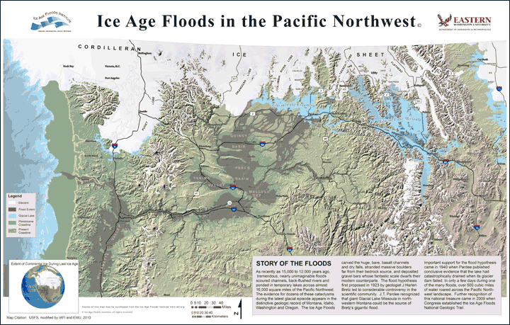
Recent vicariance out of Columbia Basin
Seattle
Moscow
Missoula
Portland
Cascades

Slide 5
Rough outline of b and d
Starting area d
Starting area b
~22,000ya
~10,000-9,000 ya still constant pop; north and south interior begin to separate
~12,000-10,000 ya
b: constant pop
d: pop expansion
After 9,000ya massive pop contraction begins

Slide 6
Rough outline of c, e, f, and g
Starting area e and g
Starting area c and f
~22,000ya
~9,000-5,000 ya still constant pop; north and south interior separate
~12,000-10,000 ya
c and f: constant pop
e and g: pop expansion
5,000-3000ya: e and f gradual pop contraction begins
5,000: g and c, quick population contraction begins

Slide 7
8: null
10:constant mig
12:Secondary contact all
tdiv (200,000-100,000)
tdiv (200,000-100,000)
tdiv (200,000-100,000)
tdiv (100,000-50,000ya)
tdiv (100,000-50,000ya)
tdiv (100,000-50,000ya)
9:Ancient mig
11:Ancient mig
interior
13:Secondary contact interior
tdiv (200,000-100,000)
tdiv (200,000-100,000)
tdiv (200,000-100,000)
tdiv (100,000-50,000ya)
tdiv (100,000-50,000ya)
tdiv (100,000-50,000ya)

Slide 8
14:Secondary contact LGM
Interior and ancient mig
16:Secondary contact LGM
tdiv (200,000-100,000)
tdiv (200,000-100,000)
tdiv (100,000-50,000ya)
tdiv (100,000-50,000ya)
Secondary contact (22,000-10,000ya)
Secondary contact (22,000-10,000ya)
17:Secondary contact LGM
Coast
15:Secondary contact LGM
Coast and int and ancient mig
tdiv (200,000-100,000)
tdiv (200,000-100,000)
tdiv (100,000-50,000ya)
tdiv (100,000-50,000ya)
Secondary contact (22,000-10,000ya)
Secondary contact (22,000-10,000ya)

